Slide 1
Tutorial 4

Slide 2
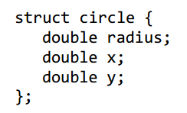


P. 1--struct
$$d\left(c1−c2\right)≤r1+r2$$
$$d\left(c1−c2\right)+r2≤r1$$
Notes:
Semantic segmentation: detect and classify

Slide 3
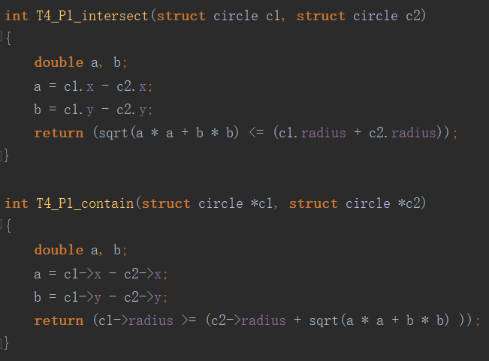
P. 1--struct

Slide 4
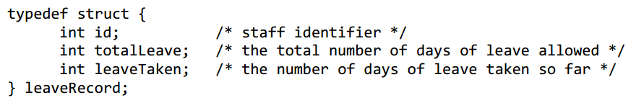
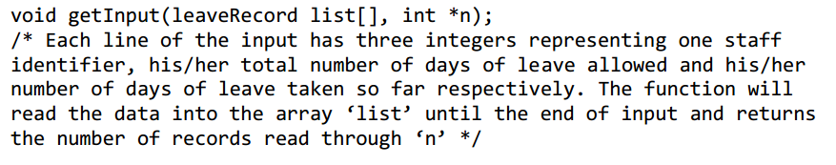
P. 2--struct
Notes:
Semantic segmentation: detect and classify

Slide 5
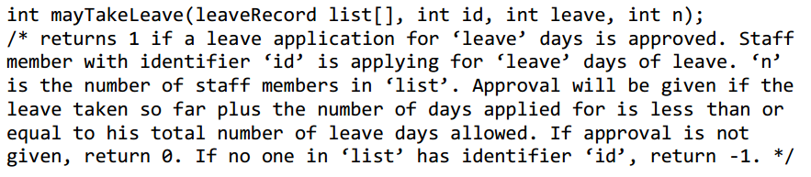
P. 2--struct
Notes:
Semantic segmentation: detect and classify

Slide 6
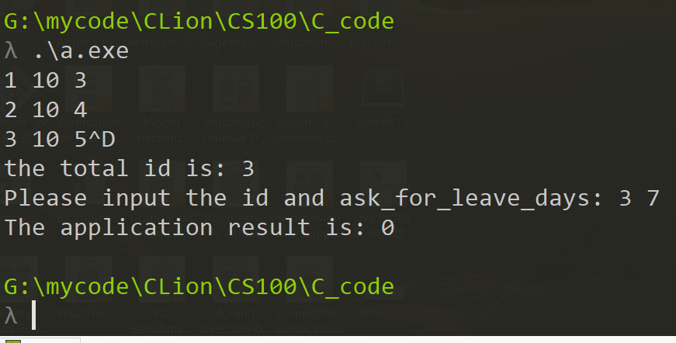
P. 2--struct

Slide 7
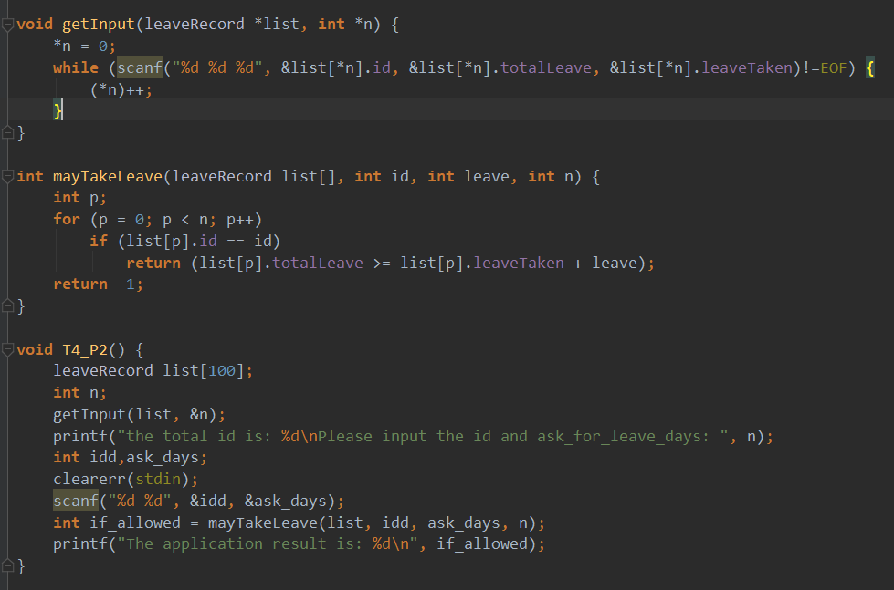
P. 2--struct
Linux/Unix
Test OK

Slide 8
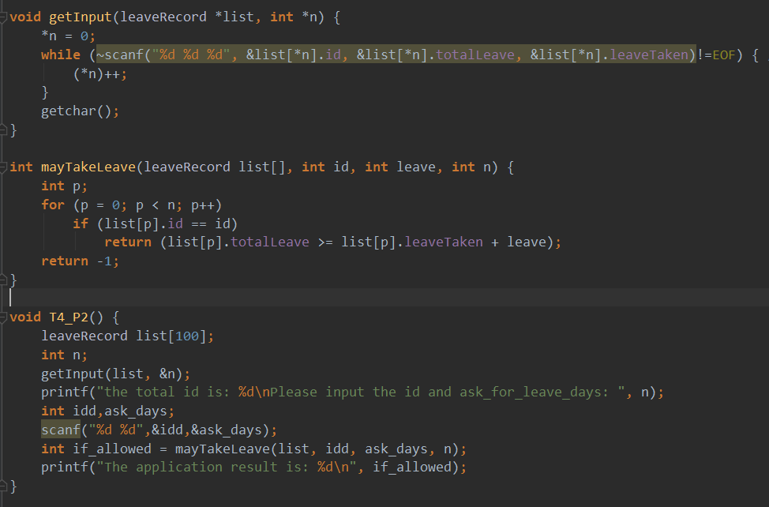
P. 2--struct
Windows
Test OK

Slide 9

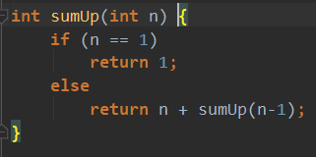
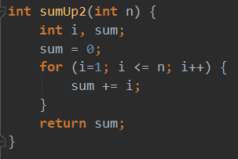
P. 3--recursive function
Recursive function
Iterative function
Notes:
Semantic segmentation: detect and classify

Slide 10
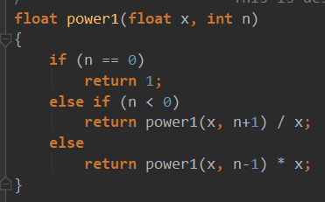
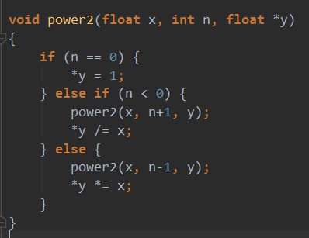

P. 4--recursive function
$$float power1(float x,int n)$$
$$void power2(float x,int n,float ∗y)$$
can be negative!

